Slide 1

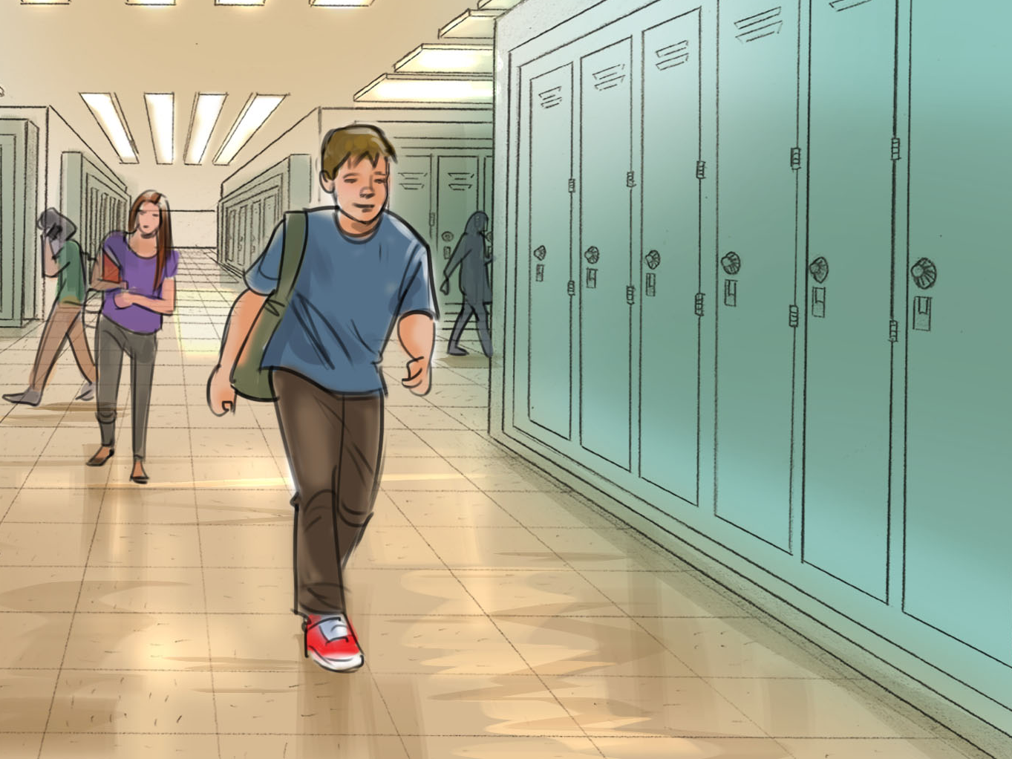


Kingdom living at school

Slide 2
School is not first (Matt. 6:33)
Christians are to “seek first God’s kingdom and His righteousness before ALL else.
What does being obsessed with Christ look like in each area of my life?

Slide 3
Beware of false teachers (Matt. 7:15-20).
“children tossed to and fro by the waves and carried about by every wind of doctrine, by human cunning, by craftiness in deceitful schemes” (Eph. 11:14).
  What is our defense?
  Our knowledge and skill within God’s Word leading to wise application.
  Examine the fruit of every teacher.

Slide 4
Reputation versus character
Love, Joy, Peace, Goodness, Kindness, Faithfulness, Patience, Self-Control, Gentleness, Discipline, Compassion, Sympathy, Persistence, Honesty, Loyalty, etc.
Make EVERY decision in our lives based on our Jesus Christ character traits.
“We must obey God rather than men” (Acts 3-4; 4:19; 5:29).
Our identity is in Christ; not earthly labels and groups (Gal. 5:28).

Slide 5
Be
Salt and Light (Matt. 5:13-16).
No “poor me”
  Stack gratitude. Write a list. Pray and thank God!
No complaining
  “Do all things without grumbling or disputing…among whom you shine as lights in the world (Phil. 2:14-15).
  “cast all your anxieties [pray] on Him” (1 Peter 5:6-7)
Bring enthusiasm and passion every day
  Vision-oriented
  “Where there is no vision, the people perish” (Prov. 29:18a KJV)

Slide 6
Receive God’s grace
Realize you need a Savior (Acts 2:37)
Believe that Jesus is the Son of God (John 3:16)
Repentance (change your heart/mind from sinfulness to obeying God [Acts 17:30])
Confess Jesus is the Lord (Romans 10:9)
Ask God for mercy and forgiveness by faith in God through immersion in water (baptism) (Acts 2:38; 1 Peter 3:21)

